Slide 1
Paper 3: Investigating Business in a Competitive Environment PAPER B Q1d

Slide 2
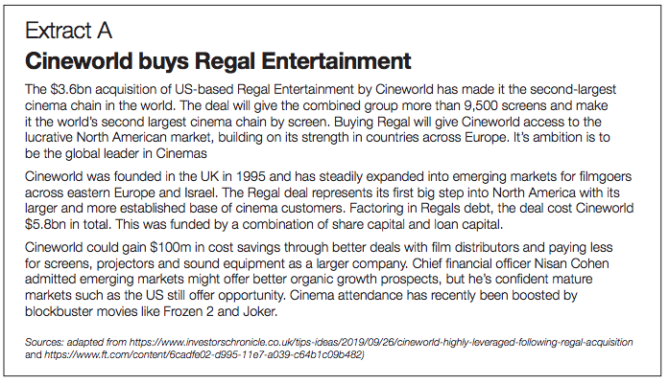
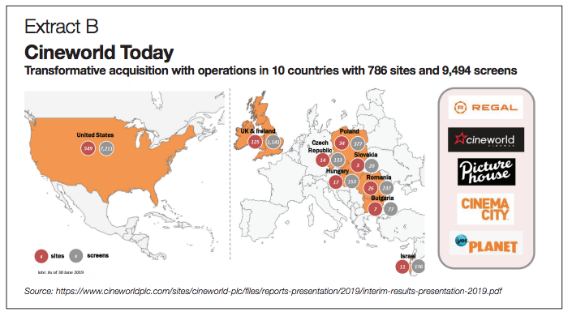

Slide 3
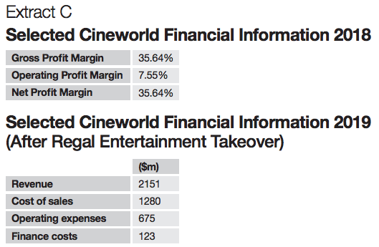
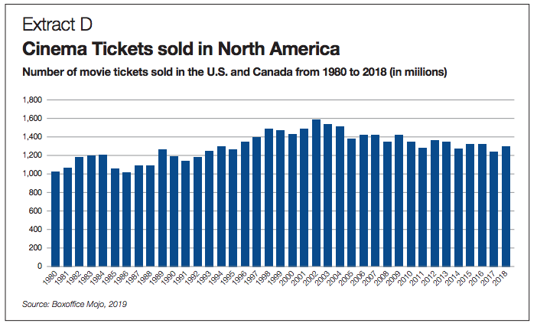

Slide 5
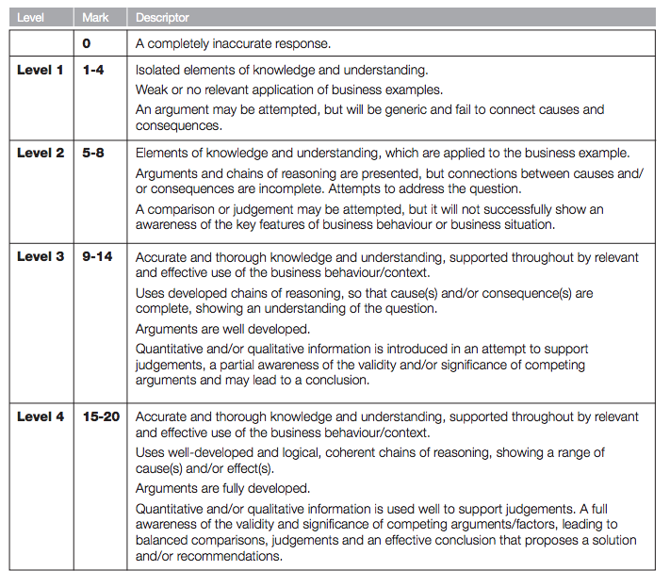

Slide 6
STEP 1:
Knowledge/understanding of what is meant by corporate objectives and profit
Corporate objectives are those that relate to the business as a whole. They are usually set by the top management of the business and they provide the focus for setting more detailed objectives for the main functional activities of the business
STEP 2:
You now need to state that Cineworld has the option of expansion in either Eastern Europe or more mature markets such as the USA. Therefore, Cineworld needs to analyse the relative costs and benefits of each option and make a decision which offers the highest potential net benefits – taking factors such as the time period into account.
I would look at the possible benefits of each in turn – but make sure that you are using the extract – otherwise you can get ‘stuck’ in Level 2

Slide 7
STEP 2:
Option A: Eastern Europe
Given watching a film is not a necessity and more of a luxury purchase Cineworld should look to see where GDP is growing at a healthy rate – this would mean that consumers have more disposable income to spend on non-essential goods and services – therefore, looking at Extract E we can see that Romania is growing at a faster rate (4.1%) compared to the USA figure of 3%. This means that Romanian incomes are rising at a faster rate (even though they are still likely to be lower than USA incomes) and therefore, they will be more inclined to enjoy these luxuries. If we assume that cinema visits are income elastic then the percentage rise in incomes (which unfortunately we do not have) is likely to lead to a proportionately greater increase in the demand for attending cinemas, bringing more revenues into the business, and assuming that this is at a greater rate than increased costs would increase the profits for Cineworld – this is an important consideration for Cineworld to take into account.
STEP 2:
Option A: Eastern Europe
One consideration Cineworld must take into account is the extent to which expansion would necessitate the need for additional marketing – if Cineworld is unheard of in a region then significant expenditure would be needed to raise customer awareness of who it is. However, Extract B shows that Cineworld is already established in Romania with 26 cinema complexes with the capacity to show 247 films at any one time. Therefore, this potential risk is minimised and applying the Ansoff matrix theory then Cineworld would be in effect be undertaking market penetration with low risk given that they already have a presence in this region and are sensitive to any particular unique tastes of the types of films to show and snacks to serve in Romania – both of which increases the chances of expansion into the region succeeding, thereby achieving its corporate objective of increasing profit.

Slide 8
STEP 2:
Option A: Eastern Europe
Another potentially attractive reason why Cineworld should consider expansion in Eastern Europe is that Extract D shows that following a peak of approximately 1,600,000,000 tickets being sold in 2002, ticket sales have gradually fallen over time in the USA and are somewhat static around the 1,100,000,000 to 1,200,000,000 level. This suggests that the USA market is not expanding – possibly due to the fact that consumers in the USA might have more alternative luxury products to spend their disposable income on. As a result, any expansion into the USA might not generate sufficient additional revenue to cover the increased costs associated with expansion within a static market. However, to be absolutely, certain on this point it would have been useful to have been given the corresponding data for Romania.

Slide 9
STEP 2:
Option B: USA
Indeed, if we assume that attendance at the Cinema is not a necessity then although it will perhaps have a lower income elasticity estimate than Romania, it will still be income elastic and whilst a 1% increase in USA incomes is likely to lead to a smaller percentage increase in quantity demand than in Romania, the actual $ increase in revenue will be much higher, therefor increasing profits more as Cineworld will already have the license to show the films in its cinemas so additional costs are not likely to increase at the same rate.
This is especially true when we see that the equivalent price in the USA ($9) is more than double that in Romania ($4.41)
Finally – extract B shows that with 549 sites and over 7,200 screens Cineworld is already a dominant force with well established supply chains to get the products it needs to function. Therefore, opening up even more screens allows the company the chance to enjoy even more economies of scale which would reduce unit costs and increase profitability.
STEP 2:
Option B: USA
The question refers to the USA as an established market. This essentially means that whilst its rate of economic growth might be less than other countries, its value of GDP per 1000 people (per capita) is likely to be higher. This is true for the USA because looking at Extract E we can see that although GDP is less for the USA at 3% then it is 3% of a much higher value – therefore it is clear that Americans have more income per capital than do Romanians ($55220 compared to $10813). Subsequently if might be more attractive for Cineworld to expand in the USA as income per capita is approximately 5 times greater so one might assume that Americans have greater amounts of disposable income to spend on luxury products such as attending a cinema – therefore, there are strong arguments to recommend the USA as the destination of expansion to achieve its corporate objectives

Slide 10
STEP 3:
Make your recommendation
Having weighed up the relative merits of each option – Cineworld could reasonably expect either option to improve overall profitability
In the short-term, it might be more prudent to focus its energies in USA option because if we assume that it the many years of higher GDP per capita (in $ terms) then USA consumers will have accumulated significantly more reserves of monies that are available for leisure expenditure. Moreover, although the Romanian growth in percentage terms is higher then it might take a number of years of considerable growth for tastes and trends of Romanian consumers to be more confident in spending their incomes on non-essential products. At the current time, it is more likely that any additional incomes received would be saved or spent on more essential items. If this is the case then perhaps the short-run decision might be for Cineworld to expand more in North America.
However, in the longer term, Cineworld will need to look for growing markets as the market for watching films might become more saturated in the USA. Therefore, when incomes continue to grow in Romania and consumers become wealthier and more willing to consume leisure activities then that could be the time to expend in Eastern Europe.
Ultimately, it will depend on how confident Cineworld is on the future economics prospects for Romania, the time frame that they are considering expansion within, plus the views of shareholders who might want higher short-term profits from the USA rather than take a longet term view and look to growing markets such as Romania.

